Slide 1
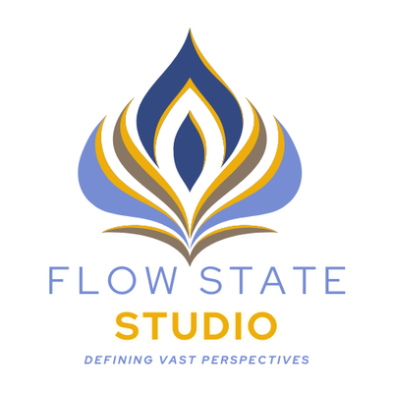

ZENDOODLE ART
Cultivating Mindfulness Through Creative Flow
WORKSHOP FOR ALL AGE GROUPS
BY NANCCY MEHTA

Slide 2
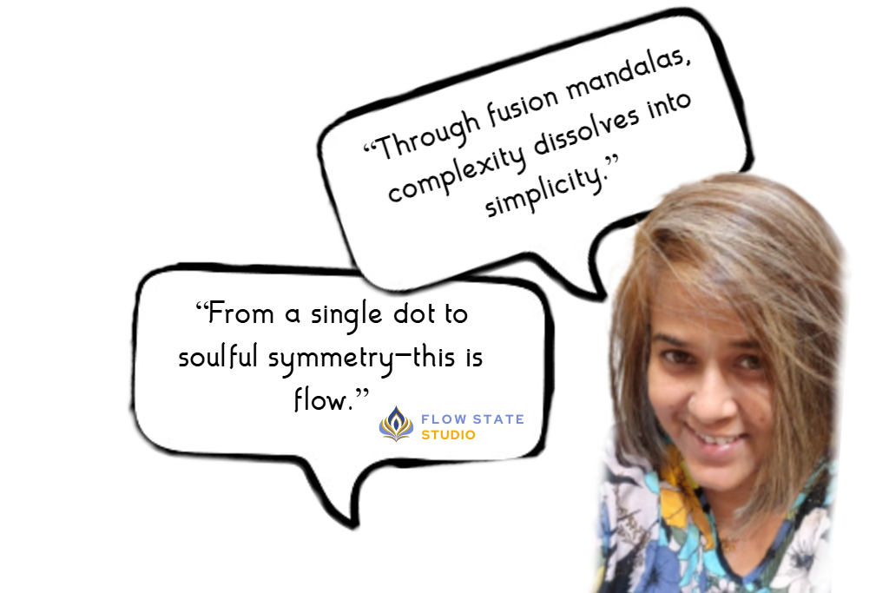
1
Hello,
2
3
4
I’m Nanccy Mehta
5
Artist, Flow State Studio
6
Doodling is a powerful language—where lines speak what words cannot.
At FLow State Studio, the goal is to help students grow artistically while gently building their self-belief and inventiveness. We hold a deep belief that Zen is a way of living—one that brings balance, clarity, and enrichment, and finds its most natural expression through mindful art.
9+Years Experience
100+Workshops Completed
600+Happy Clients

Slide 3
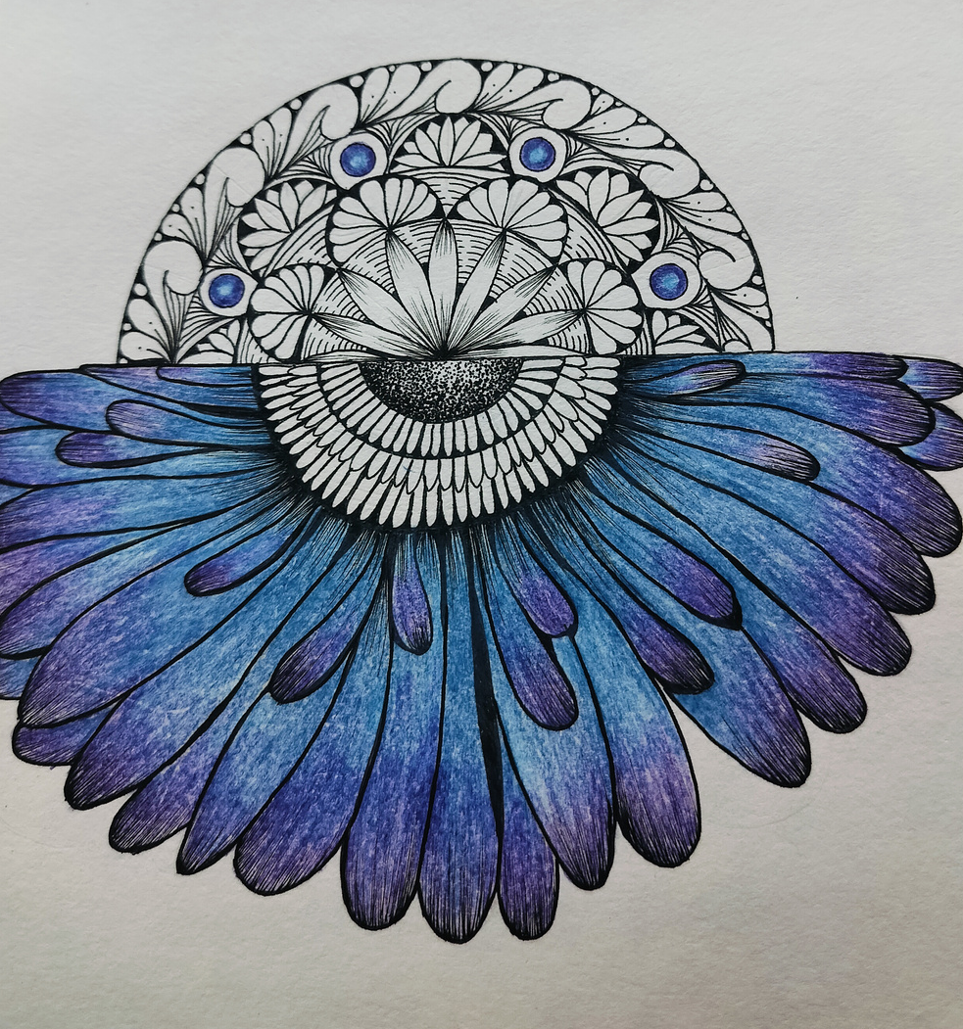
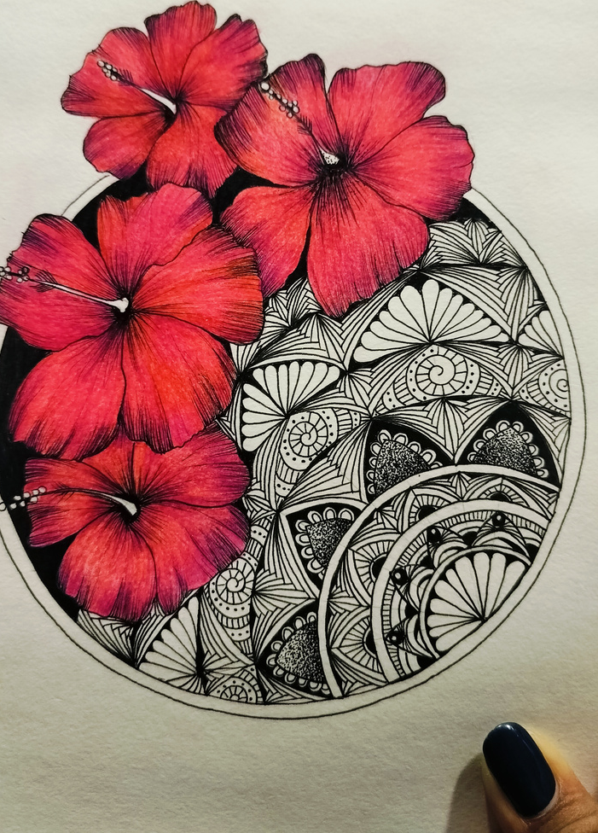
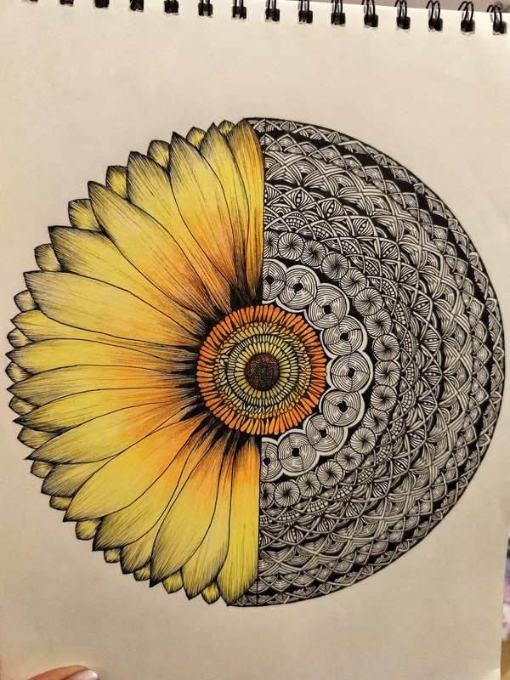
The Art of Stillness
1
2
Every person holds an inner ability to create something splendid.
Our vision is to awaken that creativity through mindful art practices. Using zen doodles and fusion mandalas as a foundation, my studio bridges inner calm with modern visual expression—where art becomes a flow state.
3
4
5
6
"In the dance of the pen, we travel from complexity to simplicity—stripping away the noise of the world to find the stillness within." -Fusionmandala

Slide 4
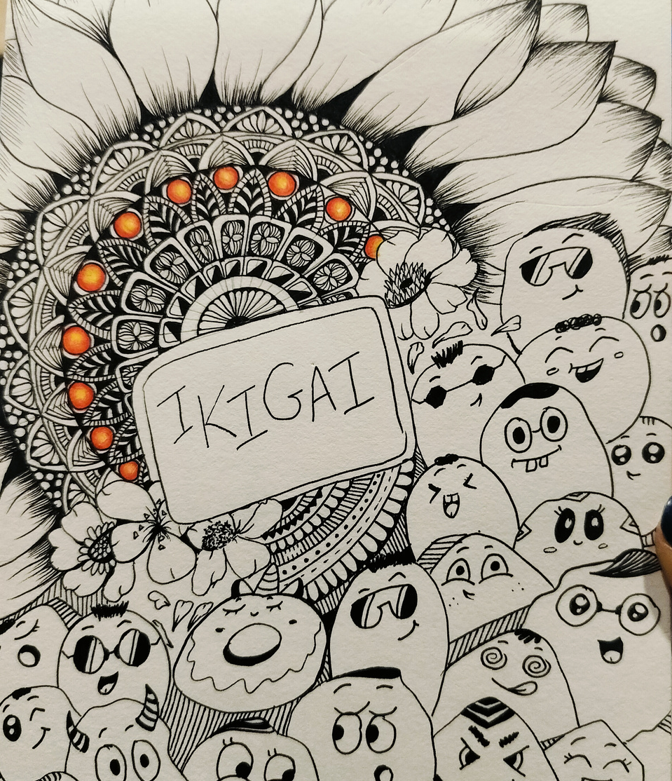

The Philosophy – Alignment & Intuition
1
2
Creative Birthright : Just as the stars align in our birth charts, our unique creative energy seeks expression.
3
3
4
5
The Concept of Ikigai: Finding your "reason for being" through the meditative process of drawing.
6
"Master the art of distilling complexity into simplicity to uncover the heartbeat of your Ikigai." -Zendoodles

Slide 5
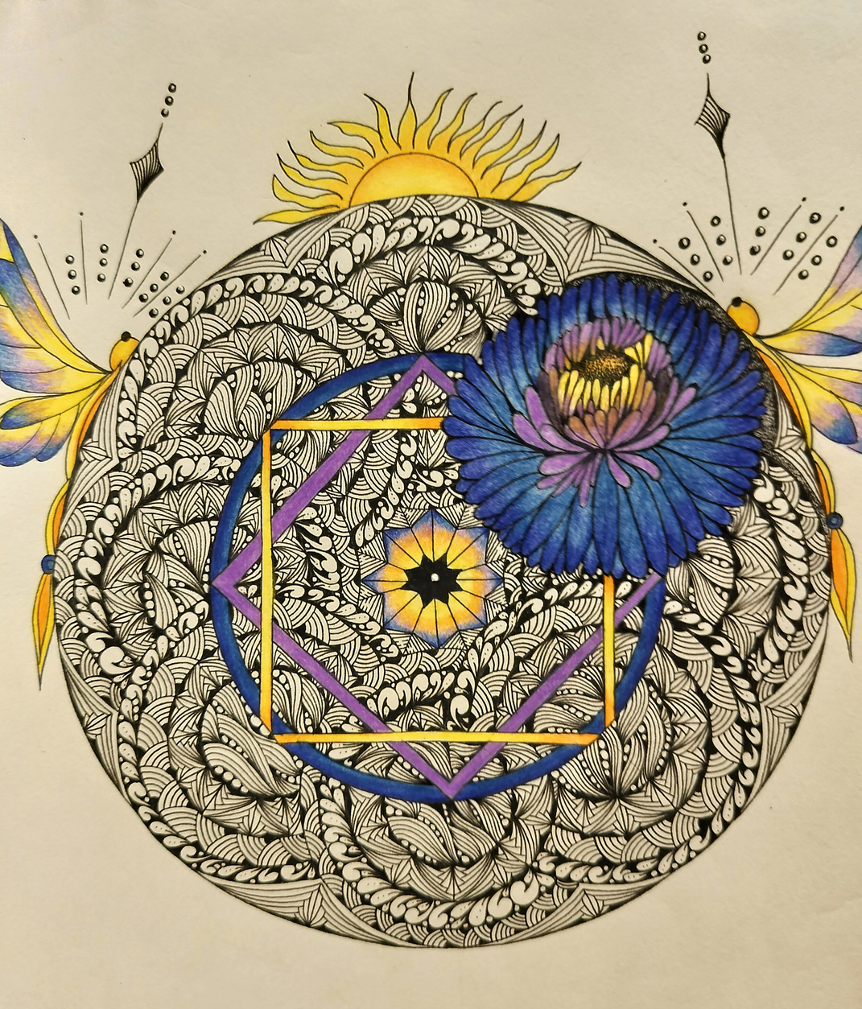
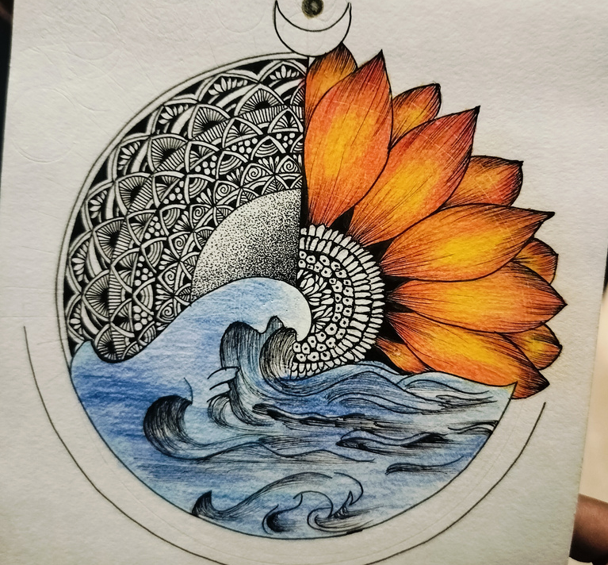
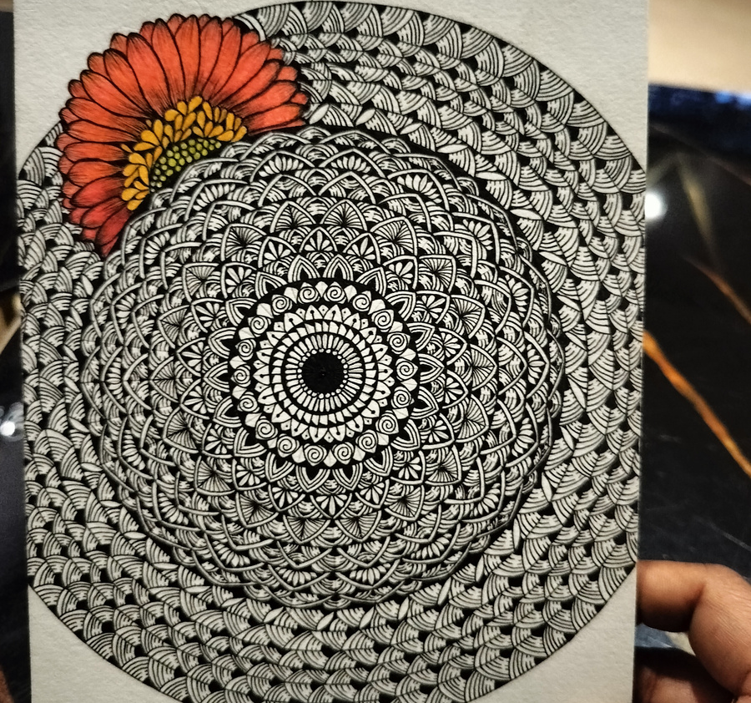
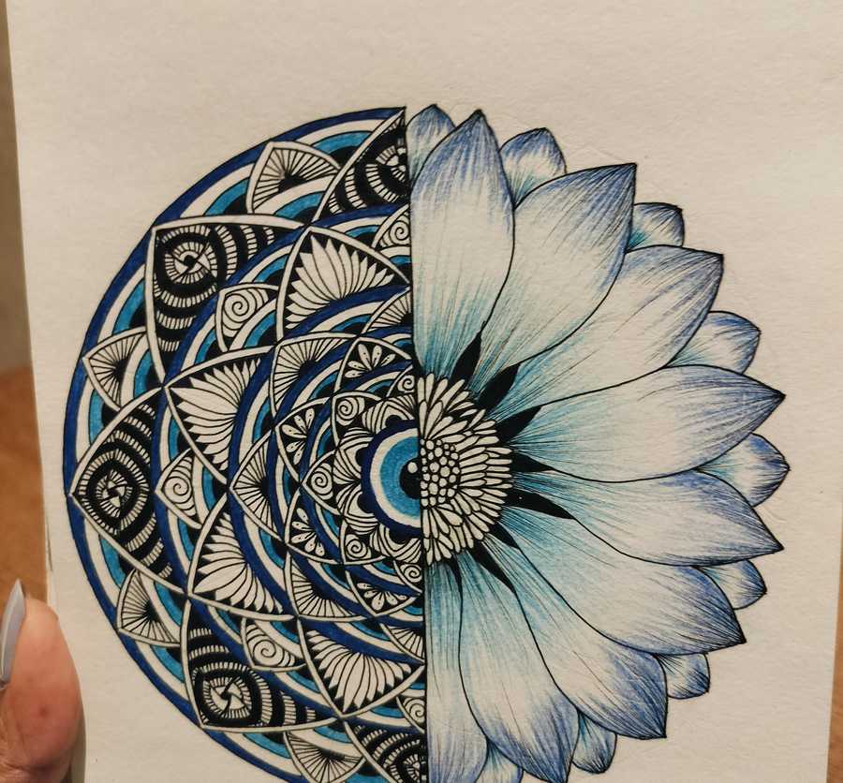
Color Therapy
Emotional Resonance
1
2
3
4
5
6
The Power of Palette: How colors like blue (calm/communication) or red (passion/action) affect our mood.
Symbolism: Integrating symbols (like the Evil Eye or Lotus) to represent protection and resilience.
Visual Meditation: Learning to "see" colors and shapes as reflections of our internal state.
"By moving from complexity to simplicity, we learn
the language of colours and the rhythm
of the soul." -ZenArt

Slide 6
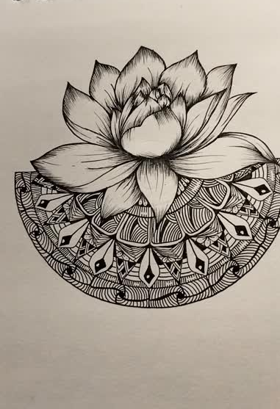
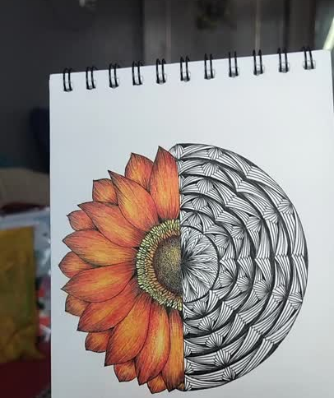
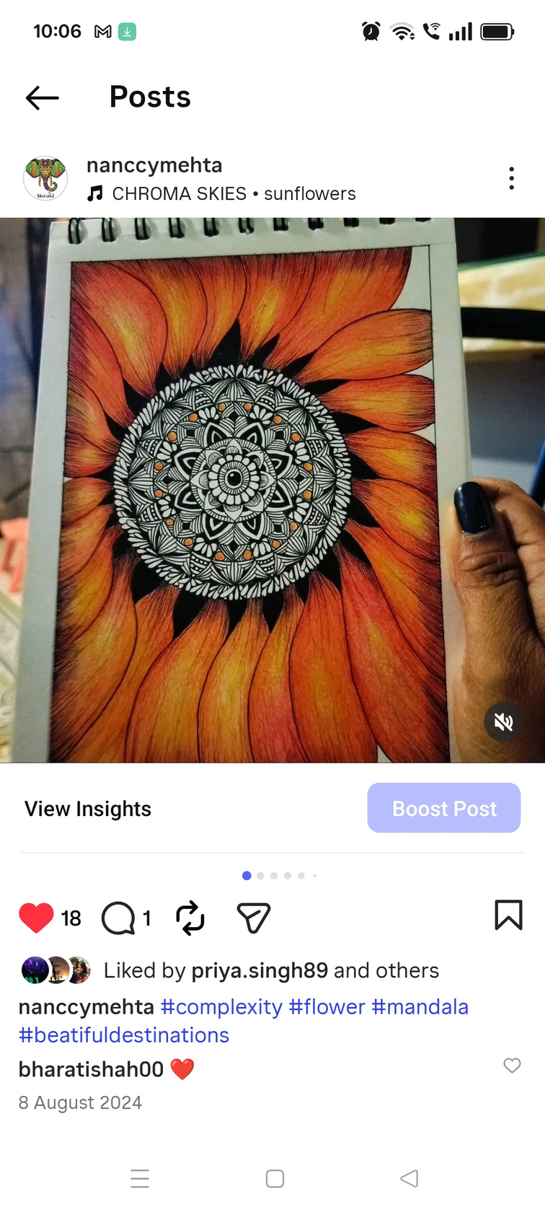
The Process
Step-by-Step Zen
1
What you’ll learn in the workshop:
1. Centering: Brief understanding of doodle art and zen art to start the session.
2. Structuring: Creating the "skeleton" of the piece.
3. Flowing: Filling in the patterns, inspired by basic lines.
4. Reflecting: The gratitude of completing a piece.
2
3
4
5
6
"Translating complexity into simplicity
through the vibrant lens of
Understanding patterns." -FusionMandala

Slide 7
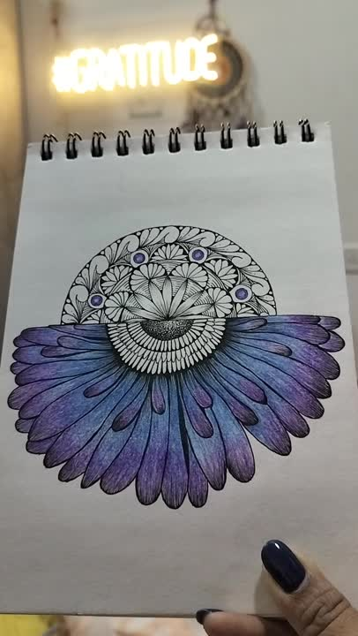
Join the Flow
1
Transform Stress into Art.
“Art is the soul's way of speaking when words are not enough."
2
3
4
5
Contact for bookings:
6
WhatsApp:
+91 98 217 803 77
Email :
Flowstatestudio37@gmail.com
Website:
www.flowstatestudio.in

